Slide 1

AuE-8230 Autonomy: Science and Systems
Capstone Project
Group 1: Chinmay Samak, Tanmay Samak
Codebase

Slide 2
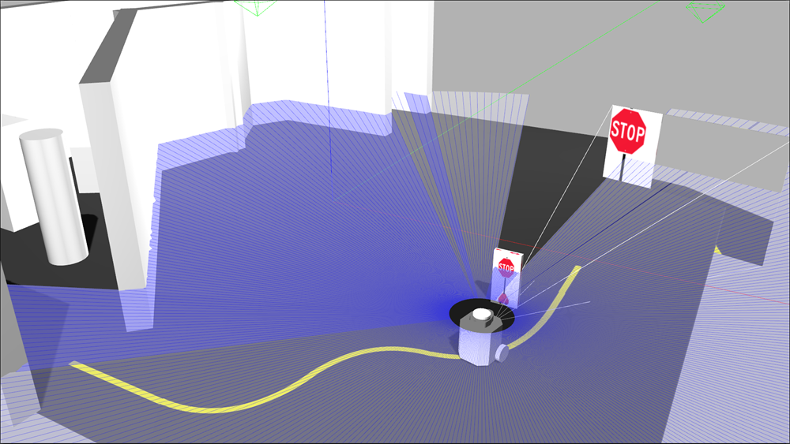
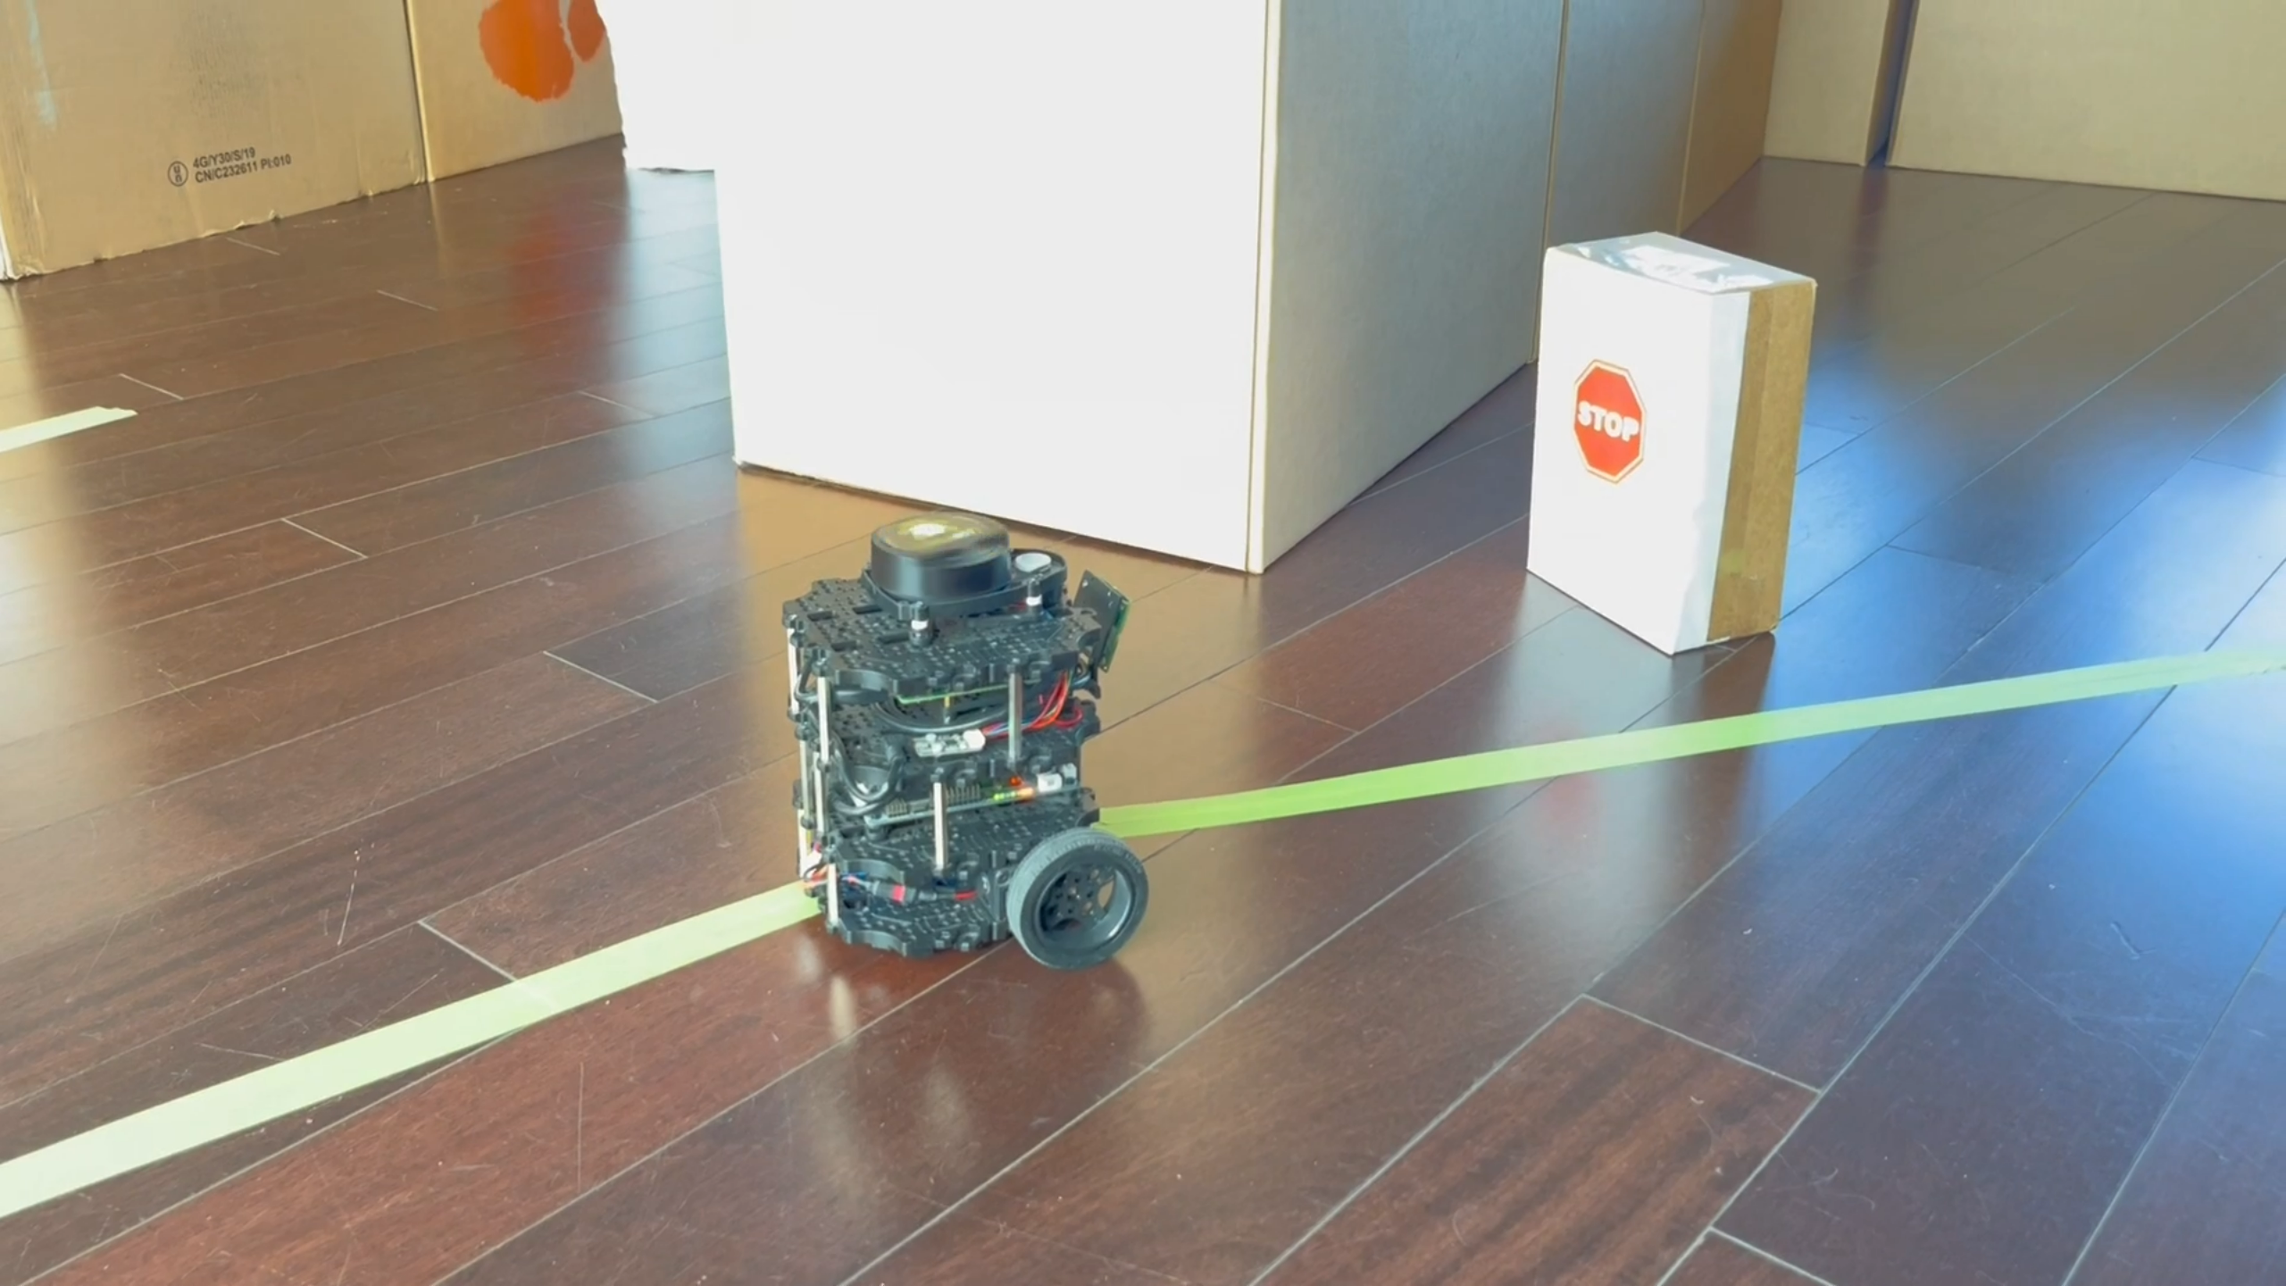
Task 4
Stop Sign Detection

Slide 3

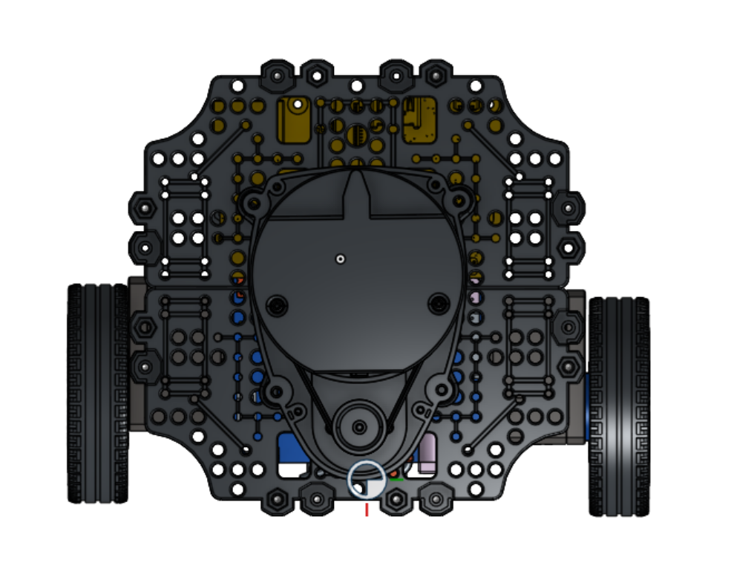
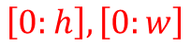
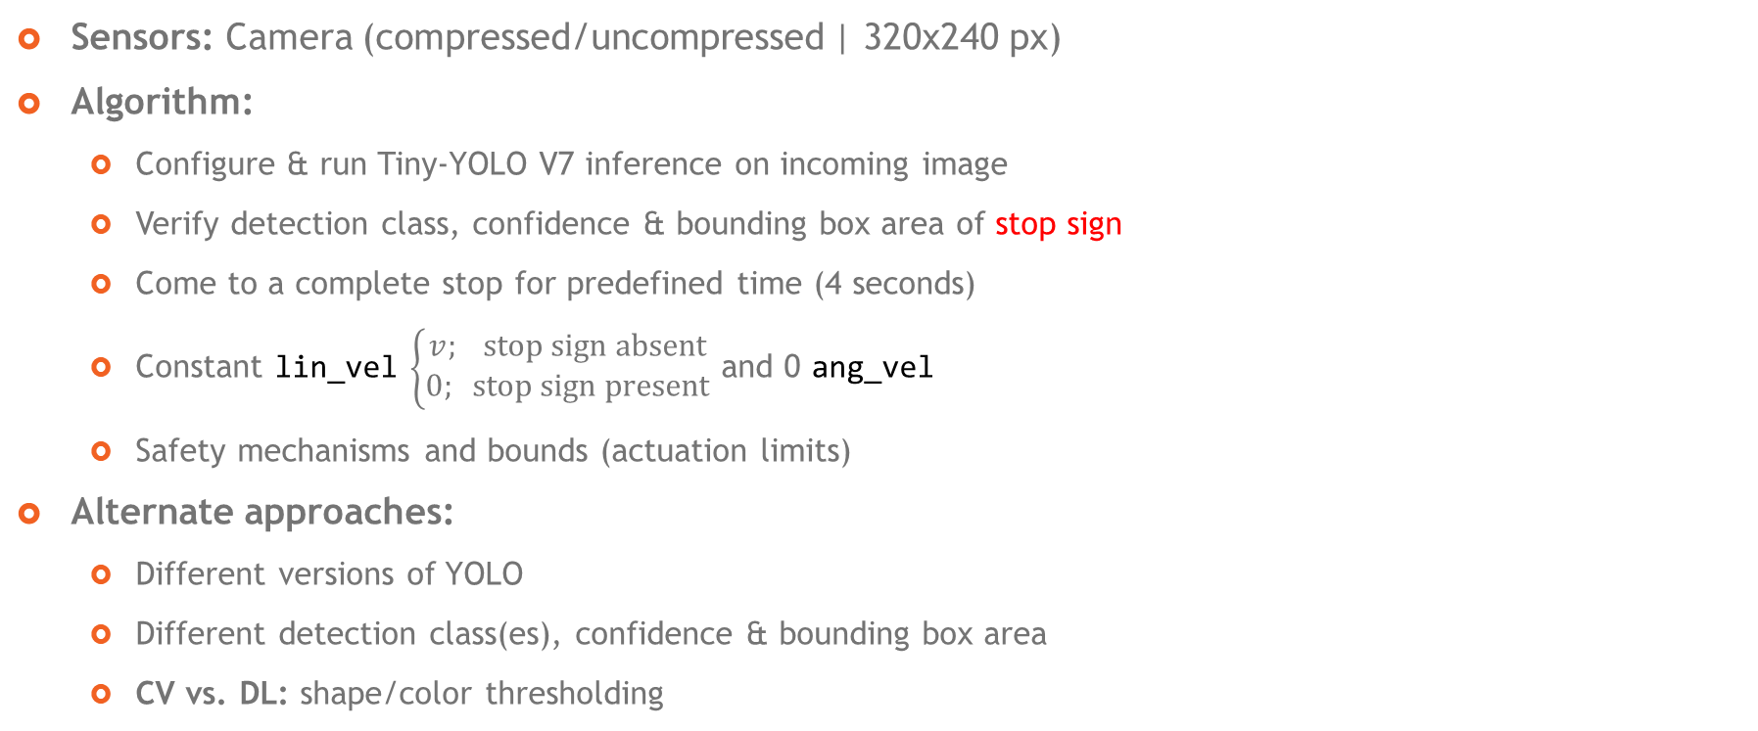
Approach
$$\left[0:h\right], \left[0:w\right]$$
Sensors: Camera (compressed/uncompressed | 320x240 px)
Algorithm:
Configure & run Tiny-YOLO V7 inference on incoming image
Verify detection class, confidence & bounding box area of stop sign
Come to a complete stop for predefined time (4 seconds)
Constant lin_vel $\left\{\begin{aligned}v; \text{stop} \text{sign} \text{absent} \\ 0; \text{stop} \text{sign} \text{present}\end{aligned}\right.$ and 0 ang_vel
Safety mechanisms and bounds (actuation limits)
Alternate approaches:
Different versions of YOLO
Different detection class(es), confidence & bounding box area
CV vs. DL: shape/color thresholding

Slide 4
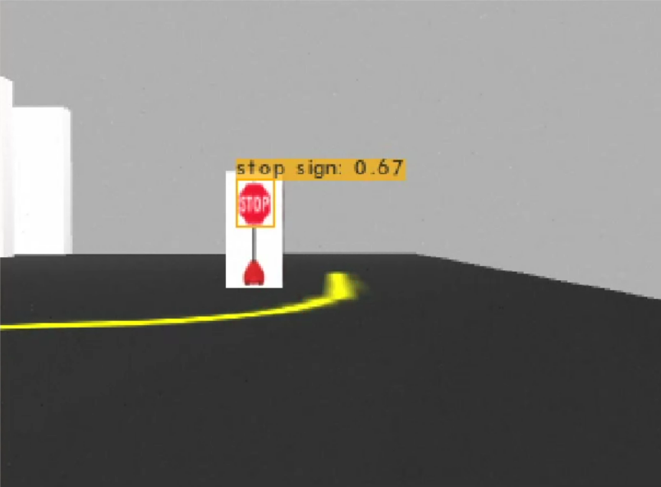
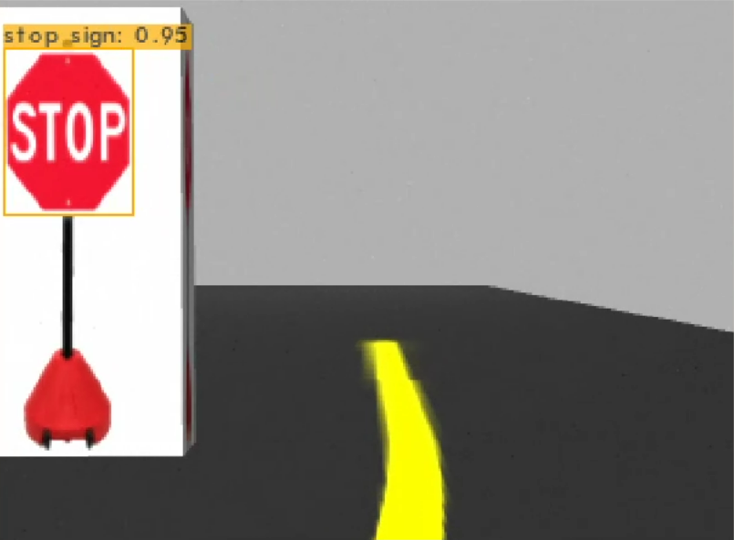
Approach
Sensors: Camera (compressed/uncompressed | 320x240 px)
Algorithm:
Configure & run Tiny-YOLO V7 inference on incoming image
Verify detection class, confidence & bounding box area of stop sign
Come to a complete stop for predefined time (4 seconds)
Constant lin_vel $\left\{\begin{aligned}v; \text{stop} \text{sign} \text{absent} \\ 0; \text{stop} \text{sign} \text{present}\end{aligned}\right.$ and 0 ang_vel
Safety mechanisms and bounds (actuation limits)
Alternate approaches:
Different versions of YOLO
Different detection class(es), confidence & bounding box area
CV vs. DL: shape/color thresholding

Slide 5

Approach
START
Initialize
Subscribe Image
Sensors: Camera (compressed/uncompressed | 320x240 px)
Algorithm:
Configure & run Tiny-YOLO V7 inference on incoming image
Verify detection class, confidence & bounding box area of stop sign
Come to a complete stop for predefined time (4 seconds)
Constant lin_vel $\left\{\begin{aligned}v; \text{stop} \text{sign} \text{absent} \\ 0; \text{stop} \text{sign} \text{present}\end{aligned}\right.$ and 0 ang_vel
Safety mechanisms and bounds (actuation limits)
Alternate approaches:
Different versions of YOLO
Different detection class(es), confidence & bounding box area
CV vs. DL: shape/color thresholding
Subscribe YOLO Detections
Tiny-YOLO V7 Inference
No
Detection Class is Stop Sign?
Yes
No
Detection Probability > 0.5?
Yes
No
Bounding Box Area > 1000?
Yes
Start Timer
LIN_VEL = $v$
ANG_VEL = $ω$
No
Elapsed Time >=
4 sec?
Yes
LIN_VEL = 0
ANG_VEL = 0
Bound LIN_VEL and ANG_VEL
Publish CMD_VEL =
{LIN_VEL, ANG_VEL}
END

Slide 6
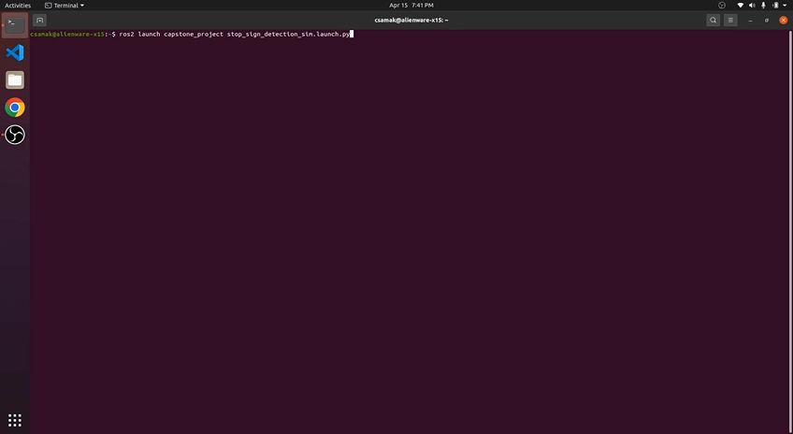
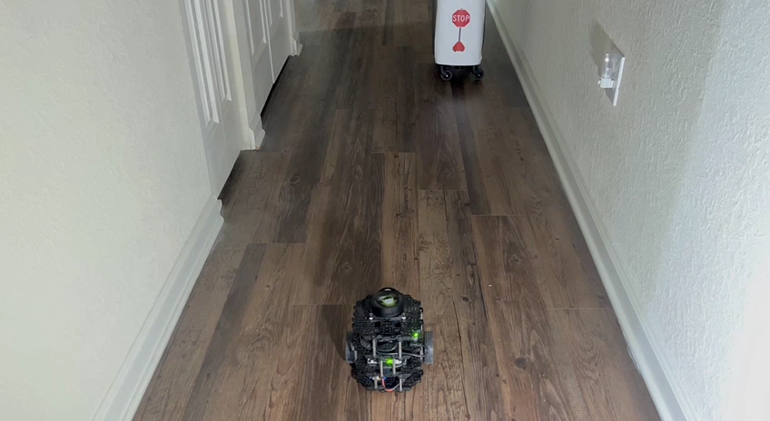
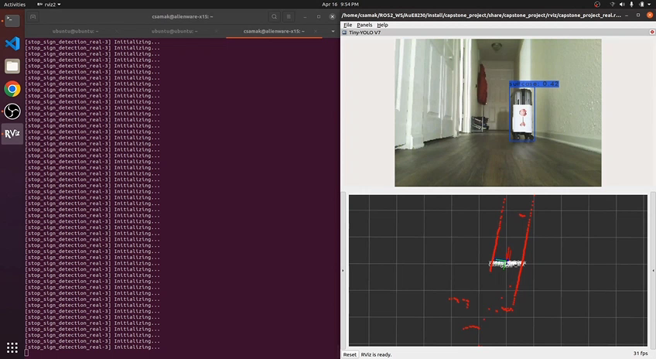
Results
Simulation
TurtleBot3
Remote PC

Slide 7
Thank you!
…open to questions and suggestions

